Slide 1


ProgressPulse
Transforming the method of Academic Evaluation

Slide 2
Project Objective
In conventional system, students are judged for their performance based on their academic records.
Scope of improvement is considered proportional with the past and current academic grade.
Consideration of other parameters crucial for the student's scope of improvement
To provide constructive feedback and actionable insights along with evaluating the scope of improvement.

Slide 3
Methodology Implemented
The project is developed considering the problem-solving approach of "Systems Thinking"
It is an approach to problem solving which takes into account the overall system as well as its individual parts
Peter Sange - "It is a framework for seeing interrelationships rather than things, for seeing patterns rather than static snapshots. It is a set of general principles spanning fields as diverse as physical and social sciences, engineering and management."

Slide 4
Methodology Implemented
Why Systems Thinking ?
In context to the project, here academic grades are being considered as a sole parameter for the scope of improvement of the student.
But there are many other parameters which could play a significant role in the scope of improvement of a student.

Slide 5
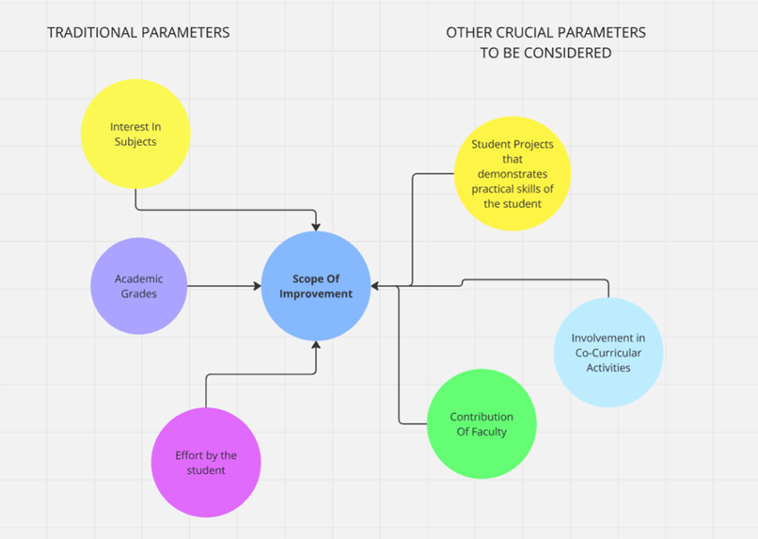
Systems Thinking approach for Project

Slide 6
Artifacts Used
We have used the survey questionnaire to collect the data from the students.
Most of the respondents belonged to third year pursuing UG programme.
Around 5 respondents were from different colleges across Tamil Nadu.

Slide 7
Overview Of Technical Implementation
ProgressPulse
ML Model Implementation for evaluating the SOI Score
Usage of Transformers model(APIs) for provision of Student Feedback
Development Of Interface for the user in the form of a webpage
Deployment of the webpage in a Free-Tier Cloud service provider.
SOI Score – Score to asses the Scope Of Improvement of a student.

Slide 8
About the ML Model And Feedback System
Implementation Of ML Model
Random Forest Regressor model has been used
Trained with trained dataset and MAE was observed to be 2
Feedback System
Used Meta(Llama 3.2) which generates text according to the parameters of the student's eavluation
Tangible User Interface
Deployment Of Webpage as a website with the help of Free-Tier Cloud Server .
Might affect the loading speed of website by 2 mins.
ML Model - Random Forest Regressor model due to lower MAE on repeated testing of datasets.
Used Meta(Llama 3.2 API) - Text generation for feedback system

Slide 9
Webpage Development And Deployement
Backend Operation Of Our Website – Developed using Flask.
Deployed the website using a cloud service that converts our webpage into a real-time website
Disadvantage : Delay in loading time of the website. Since it is deployed on free-tier, not on premium tier.

Slide 10
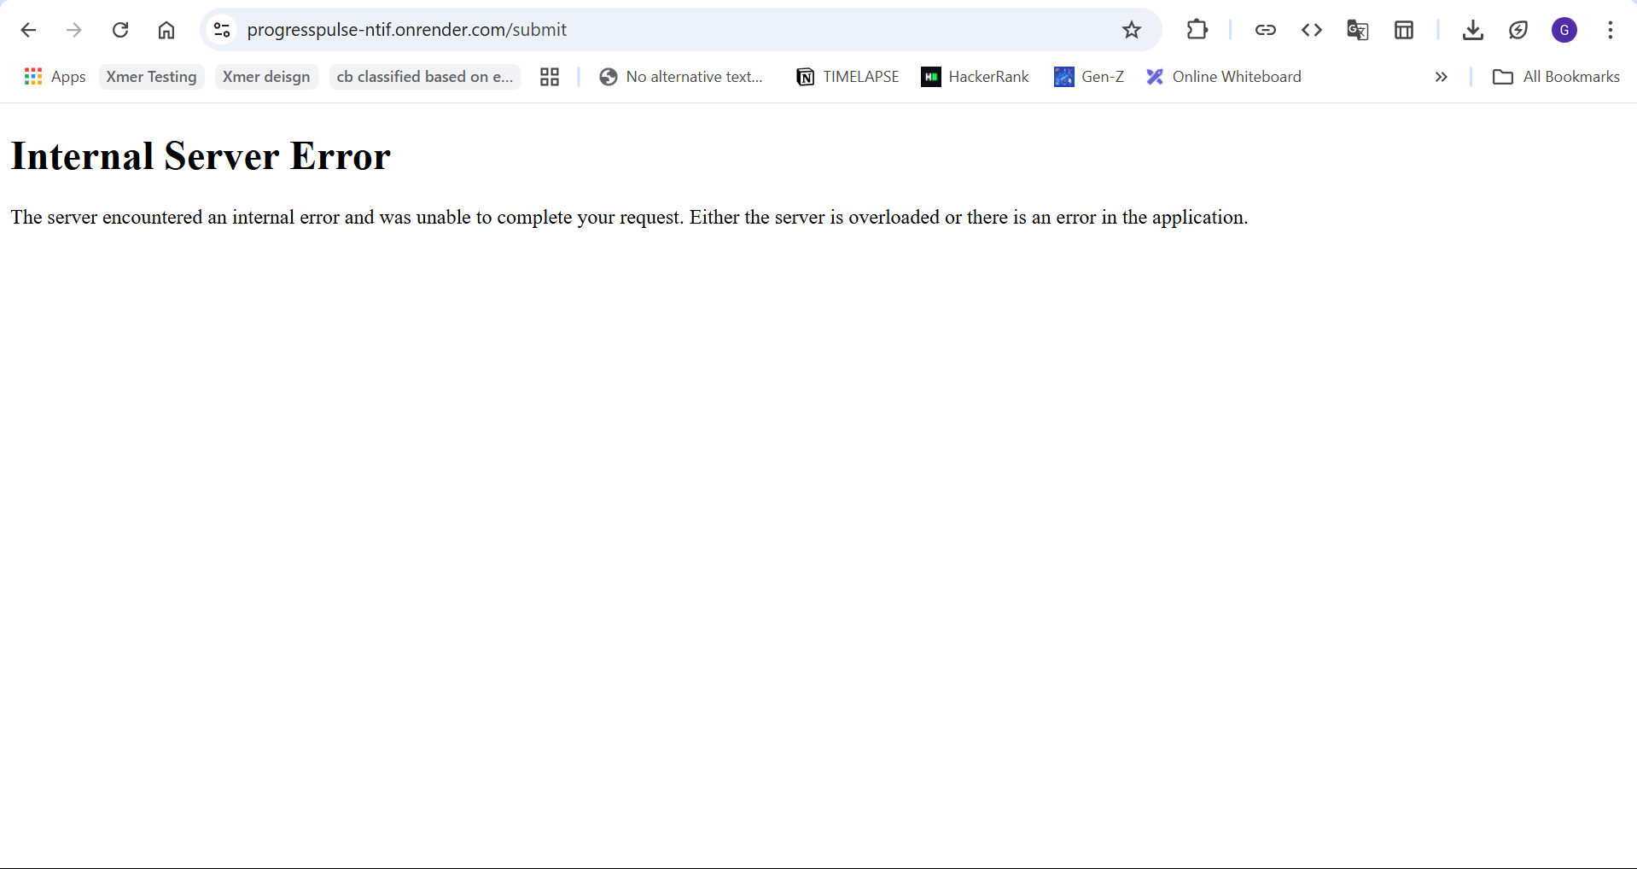
Errors and Debug Logs

Slide 11
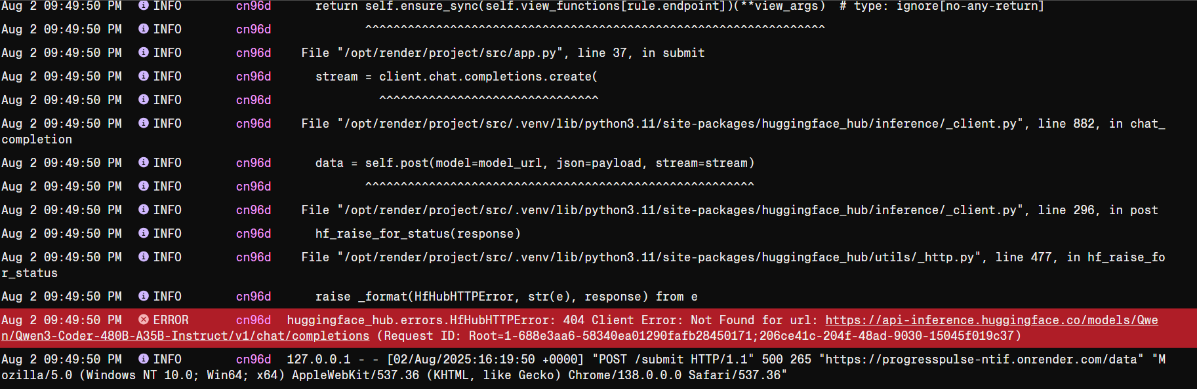
Errors and Debug Logs

Slide 12

THANK YOU
Website : https://progresspulse1.onrender.com/
Note : Delay might be there for ~2 mins

